Slide 1

Real Estate Sales Analysis
Insights from SQL Data Analysis
PRESENTATION BY:
OKEKE EMMANUEL EBUKA
MUSA BALIKIS

Slide 2
OUTLINE
Introduction
SQL Insights
Recommendation

Slide 3
INTRODUCTION
Real Estate is one of the largest and most dynamic industries worldwide, involving the buying, selling, and renting of properties.
This project explores a real estate dataset containing property listing, data transactions, agent performance, and buyer information.
Data Overview
Agents: 10 agents managing property sales.
Buyers: 50 buyers with varying budgets.
Properties: 100 properties listed across multiple cities.
Transactions: 70 completed sales.
Objectives
Analyze top performing agents
Identify sales trend across cities.
Determine total revenue and buyer trends
To Identify trends in property sales, agent performance and buyer behavior.

Slide 4
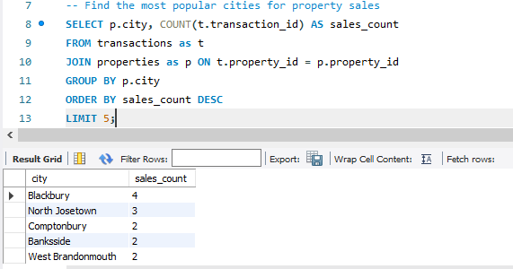
Sales Performance By City
The Table below shows the top 5 cities which had most sales.
Blackbury had the highest sales with a total of 4 houses sold.

Slide 5
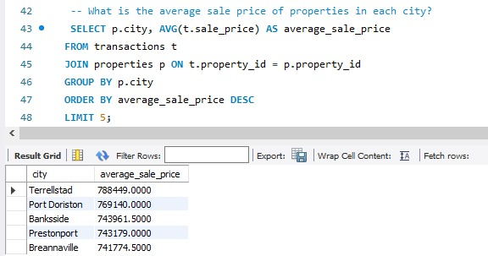
Sales Performance By City
Among the top 5 cities, Terrellstad recorded the highest average property sale price at $788,449 indicating a high-value market.

Slide 6
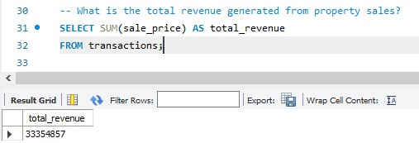
Total Revenue from Property Sales
A total of $33,354,487 was made from property sales.

Slide 7
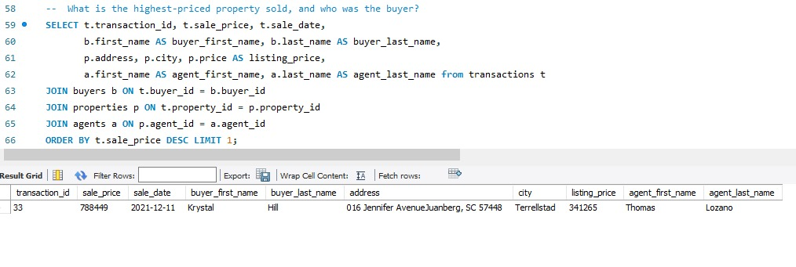
High-Value Property Sales
The Most Expensive Property was listed for $341,265 and sold for $788,449.
This property is located at Terrellstad.
Agent Thomas Lozano sold this property to Krystal Hill.

Slide 8
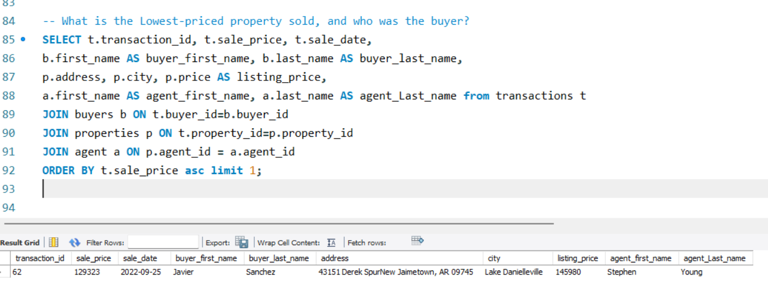
High-Value Property Sales
The Least Expensive Property sold was listed for $145,980 and sold for $129,323.
This property is located at Lake Danielleville.
Agent Stephen Young sold this property to Javier Sanchez.

Slide 9
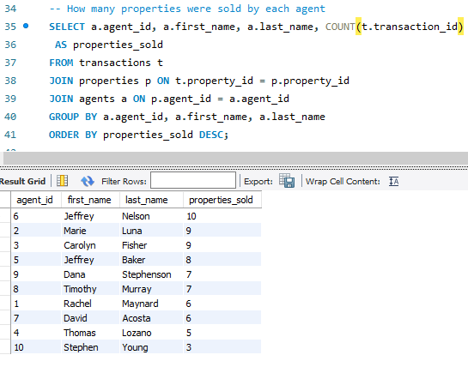
Agent Performance Analysis
The Table below shows all Agents who sold properties.
Jeffrey Nelson with Agent Agent ID 6 sold a total of 10 properties. And he recorded the highest sales.
Stephen Young with Agent ID 10 sold a total of 3 properties. And that’s the least sold by an agent

Slide 10
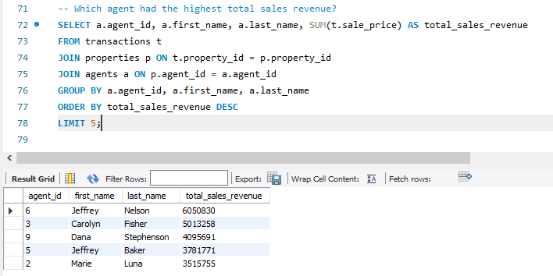
Agent Performance Analysis
The Table below shows the top 5 agents which brought in most revenue.
Agent Jeffrey Nelson brought in the most revenue by an agent totaling $6,050,830.

Slide 11
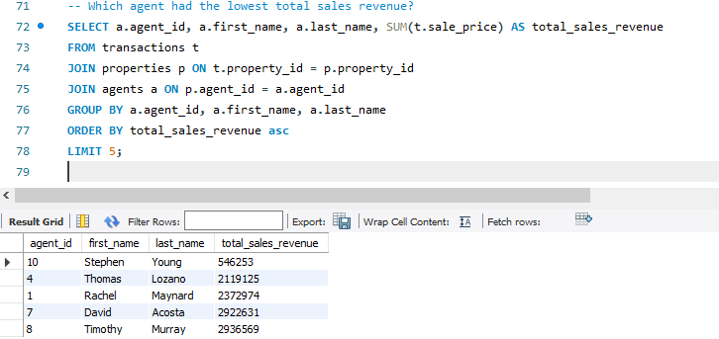
Agent Performance Analysis
The Table below shows the least 5 agents which brought in revenue.
Stephen Young with Agent ID recorded the least revenue totaling $546,253.

Slide 12
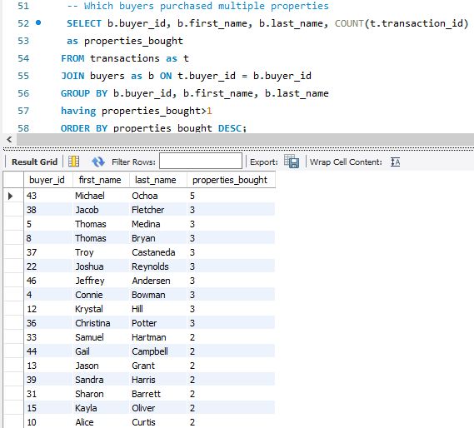
Buyer Behavior and Repeated Purchase
There was a total of 17 buyers who purchased more than one property.
Micheal Ochoa bought the most properties

Slide 13

RECOMMENDATION
Some buyers are likely investors acquiring multiple properties, so targeted marketing efforts could increase repeated purchases.
Top Agents can mentor or train new sales personnel.
Expansion of sales strategies in underperforming cities could increase revenue.
Targeted marketing efforts on lower-priced properties could potentially attract first time homebuyers and investors.
Expansion into emerging high-demand cities.
Build long-term relationships with frequent buyers.

Slide 14

THANK
YOU

